Slide 1

POWERBI PROJECT: HOTEL AGGREGATOR ANALYSIS
BY AKINNIKU IBUKUN
HOTEL

Slide 2
TABLE OF CONTENTS
1
2
3
Geographical Insights
Pricing and Availability
Host Performance
4
5
6
Review Scores
Property and Room Type Analysis
Recommendation

Slide 3
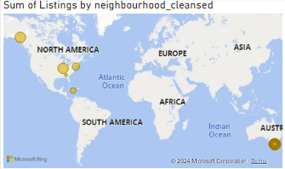
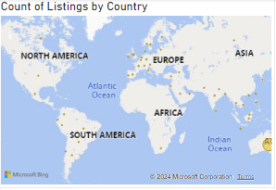
GEOGRAPHICAL INSIGHT
The Distribution Of Listings On A Map To Identify Popular Neighborhoods.
Geographical Concentration Of Listings And Host Locations.

Slide 4
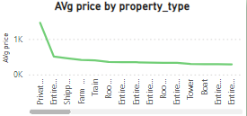
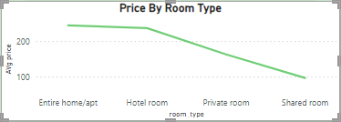
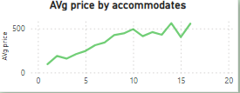
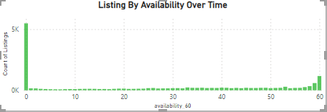
PRICING AND AVAILABILITY ANALYSIS
PRICE TRENDS BASED ON PROPERTY TYPES, ROOM TYPES, AND ACCOMMODATION CAPACITY
AVAILABILITY OF LISTINGS OVER TIME AND IDENTIFY PEAK PERIODS

Slide 5
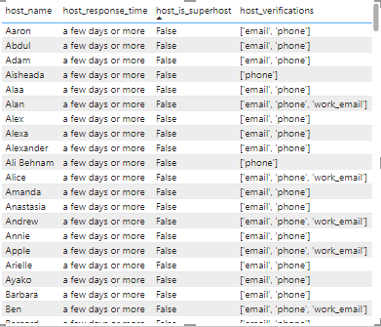
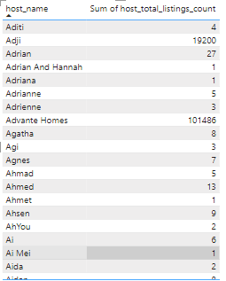
HOST PERFORMANCE
Host Characteristics, Including Super host Status, Response Times, And Verification Methods
Correlations Between Host Attributes And Listing Performance

Slide 6
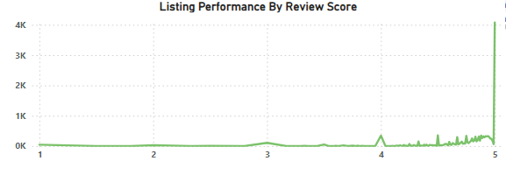
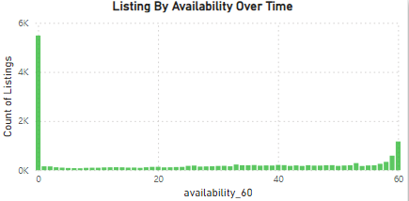
REVIEW SCORES
Review Scores And Their Impact On Overall Listing Performance.

Slide 7
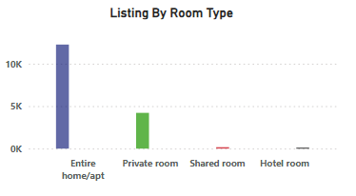
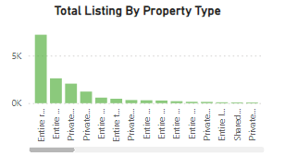
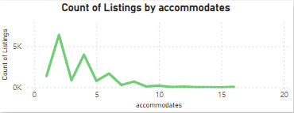
PROPERTY TYPE AND ROOM ANALYSIS
Distribution Of Property Types And Room Types
Popularity Of Specific Accommodation Setups

Slide 8
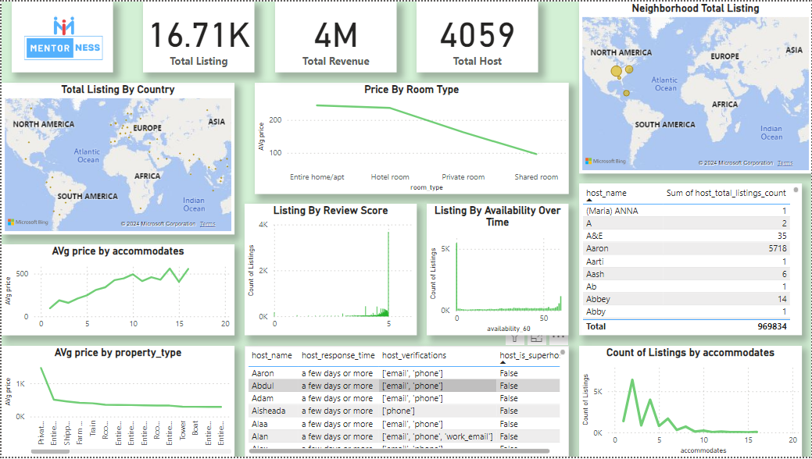
DASHBOARD

Slide 9

—AKINNIKU IBUKUN
RECOMMENDATION
Australia has the highest number of listing
The shared room type is the only affordable room type
Homes/apt are the most expensive than private and hotel
Large accommodation tends to have higher prices
RECOMMENDATIOIN

